Slide 1
Challenges Faced by Vietnamese Students in English-Medium Instruction Programs in Taiwan: A Mixed-Methods Study Combining Qualitative Analysis and Machine Learning
FREDE WU & JACOB REIDHEAD

Slide 2
AUTHORS
Affiliation: National Chengchi University NCCU, Taipei, Taiwan
Position: PhD student of Asia Pacific Studies
Latest Graduation: MBA from Chinese Culture University, TW; Bachelor of English Linguistics from Lac Hong University
Experience: 5+ years working in industries with top companies in the field such as Hitachi Vietnam, ILA Vietnam, KMS Technology, & Muse Communication; 4+ years working as Teaching Assistant, and now Research Assistant
Research Interests: Higher Education Enhancement, Media & Social Media
Frede Wu
Affiliation: National Chengchi University NCCU, Taipei, Taiwan
Position: Assistant Professor of Social Sciences Department
Latest Graduation: PhD Sociology of Stanford University, MA Sociology & MA Statistics of University of Washington & Ohio State University, and so on.
Experience: Fellow in Stanford & Taiwan Gov; Teaching & Researching positions in Taiwan, Kazakhstan, and Korea
Jacob Reidhead

Slide 3
LIST OF CONTENT
01.
OVERVIEW
02.
RESEARCH QUESTIONS?
03.
METHODOLOGY
04.
DATA DESCRIPTION
05.
DATA PRE-PROCESSING (FOR LDA)
06.
RESULT 1 & 2
07.
DISCUSSION
08.
CONCLUSION & RECOMMENDATION

Slide 4
OVERVIEW
Introduction
In the increasingly globalized prospect of higher education, English-Medium Instruction (EMI) programs have emerged as a prominent strategy to attract and support international students. Given their significant presence as the largest source of international students in Taiwan, with 20,000+ students (RTI, 2023), Vietnamese students serve as dynamic representatives uniquely poised to explore the multifaceted advantages of higher education issues in Taiwan.

Slide 5
OVERVIEW
Motivation
One of the key reasons more Vietnamese students choose EMI programs for their higher education in Taiwan is their perceived benefits (Dieu, 2021; Chang, 2023). However, when those students experience the EMI courses, they may find drawbacks related to language ability, pedagogical methods, and other factors (Chou, 2016; Huang, 2020). Accordingly, This leads to the research question:
Motives
Challenges

Slide 6
RESEARCH QUESTION
1.What are the challenges that correspond with the students' real-life experiences?
2.How can Machine Learning precisely forecast those challenges?

Slide 7
LITERATURE REVIEWS
State Shift in Administration
1987: Transition from centralized to government-regulated and market-driven management (Chou, 2015).
Economic Context
Taiwan: One of Asia's four economic tigers.
1990s: Dynamic capitalist economy with reduced government control over investment and trade (Dent, 2003).
2021 GDP: $774.70 billion USD (World Bank), 0.33% of global economy.
Higher Education Internationalization:
MOE initiatives to attract international students (Dieu, 2021; Chang, 2023).
Goal: 320,000 foreign students by 2030 with a $162 million initiative (Huang, 2023).
EMI Benefits
Facilitates academic engagement and cultural integration (Chu, et al., 2018).
Enhances educational and cultural experiences (Gu et al., 2010; Marambe, et al., 2012).

Slide 8
LITERATURE REVIEWS
Challenges for International Students
Socio-Cultural:
Cultural adjustment, language barriers (Medved, et al., 2013; Huang & Chang, 2011).
Academic:
Academic literacy and pedagogical practices (Ryan & Viete, 2009).
Financial:
Even Taiwan’s school fee is more favourable to compare with China, HongKong, Singapore, and so on, but financial aid and scholarships impact student decisions (Vuong et al., 2021; Phan & Liu, 2022). Budget constraints, scholarships crucial (Shieh, 2014; MOE, 2009).
Health:
Mental health and well-being (Mori, 2000; Sandhu & Asrabadi, 1994; Ward, 1997; Ward & Low, 2004).
Yes, and
Internationalization of Taiwan's higher education enriches academic and cultural diversity.
Need for holistic approach: robust language support, comprehensive financial aid, accessible healthcare (Andrade, 2006; Zhang & Goodson, 2011; OECD, 2020; Li, Wang, & Xiao, 2021).

Slide 9
METHODOLOGY
Using Mixed Method from Qualitative Analysis x Machine Learning
Qualitative Discourse Analysis
Qualitative Discourse Analysis (QDA) is a research method used to study the ways in which language is used in texts and contexts. It focuses on understanding how discourse—the use of spoken, written, or sign language (Gee, 2014)
Latent Dirichlet Allocation (LDA)
Latent Dirichlet Allocation (LDA) is a generative statistical model (and inference LDA) used to classify text in a document to a particular topic. It is a popular method for topic modeling, which helps in discovering abstract topics within a collection of documents.
TASAM MODEL TO VERIFY
Based on the Transactional Acculturation Stress and Adjustment Model (TASAM) by Wu et al. (2015) & from Literature Reviews, four hypotheses regarding the challenges faced by IS are examined:
● H1: Socio-Cultural Adjustments
● H2: Academic Challenges
● H3: Financial Difficulties
● H4: Health Care Issues
Notes:
Latent Dirichlet Allocation (LDA): LDA is a generative statistical model that helps in identifying topics within a collection of documents. Each document is represented as a mixture of topics, and each topic is represented as a mixture of keywords.
Topic-Document Score Matrix: This matrix shows the degree to which each document is associated with each topic. Each cell in the matrix represents the weight or score that indicates the strength of the association between a document and a topic.

Slide 10
DATA DESCRIPTION
PCCU: Chinese Culture University
NCCU: National Chengchi University
PU: Providence University
MCU: Ming Chuan University
NTNU: National Taiwan Normal University
 | Subject 1 | Subject 2 | Subject 3 | Subject 4 | Subject 5 | Subject 6
School | PCCU | NCCU | NCCU | PU | MCU | NTNU
Year | 1 | 1 | 2 | 1 | 1 | 2.5
Interview Duration | 40 mins | 33 mins | 33 mins | 1 hour | 42 mins | 39 mins
Words (Tokens) | 537 | 633 | 673 | 898 | 644 | 702
Semi-structured interviews
Snowball sampling

Slide 11
DATA Pre-Processing
Specifically for LDA MODEL
$\frac{Weight}{Probability}$: The numbers indicate how strongly a particular word is associated with a specific topic. A higher weight means that the word is more representative or more frequently appears in the context of that topic.
$Sum of Weights$: For each topic, the sum of the weights of all words typically equals 1. This normalization helps in interpreting the weights as probabilities.

Slide 12
Qualitative
RESULT (1)
DiSCOURSE
Social-culture challenges
Theme 1 | English is not a primitive language
Theme 2 | Different nations, different lifestyles
Theme 3 | Unfavorable view from local people
Theme 4 | The challenging socialization of Taiwanese individuals outside of work and study hours
Excerpt 3: Some Taiwanese people do not like Vietnamese people very much because they think that Vietnamese people come here to make money and do not study seriously, but when I introduced myself as a student at NCCU, everyone felt more respectful of me.
Classroom challenges
Theme 5 | Teamwork as an unfavorite academic activity
Theme 6 | Local lecturers and their Mandarin persecution
Theme 7 | Silent classrooms with local students
Theme 8 | The contract of Chinese program and EMI

Slide 13
Qualitative
RESULT (1)
DiSCOURSE
Financial challenges
Theme 9 | Insufficient employment opportunities for students
Theme 10 | Insufficient time to study
Excerpt 9: I do want a paper work job but the job usually requires Chinese not only English so it is hard to find a job like that.; They come from the western region of southern Vietnam, their purpose of coming here is to work.; I often found it hard when searching for Teaching Assistant or Research Assistant positions because my department doesn't often grant it for people who have scholarships.
Well-being challenges
Theme 10 | Well-being with academic pressure
Theme 11 | Weather issues and eating habit

Slide 14
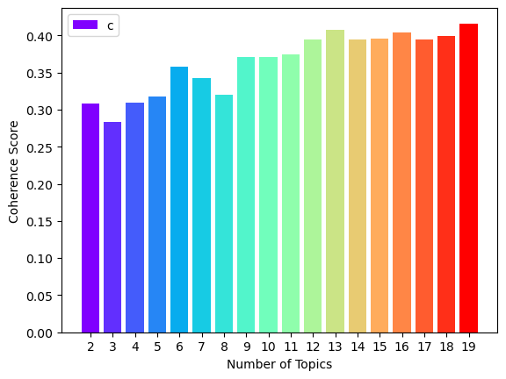
RESULT (2)
Machine learning
analysis
Macro Level
Topic no.9 to no.19 were chosen

Slide 15
RESULT (2)
Machine learning
analysis
Macro Level
No. | Bags of words | Topics | Themes
10 | 0.023*"student" + 0.011*"experience" + 0.011*"important" + ' '0.011*"challenge" + 0.009*"chinese" + 0.009*"one" + 0.007*"like" + ' '0.007*"take" + 0.007*"school" + 0.007*"find"') | Importance of Student Experience | The significance of overall student experiences in Taiwan, including navigating challenges, academic life, cultural encounters, and personal growth.
11 | 0.020*"challenge" + 0.020*"feel" + 0.018*"student" + 0.013*"chinese" + ' '0.013*"know" + 0.012*"language" + 0.011*"get" + 0.010*"lot" + 0.010*"help" ' '+ 0.010*"face" | Academic and Language Challenges | Challenges related to academic workload, language proficiency, cultural adaptation, and seeking assistance in Taiwan.
12 | '0.022*"student" + 0.016*"school" + 0.016*"make" + 0.014*"like" + ' '0.014*"come" + 0.014*"challenge" + 0.012*"taiwan" + 0.012*"feel" + ' '0.012*"country" + 0.009*"academic" | Academic Adjustment | Adjusting to the Taiwanese education system, academic expectations, cultural differences, and personal challenges.
13 | '0.021*"challenge" + 0.021*"friend" + 0.021*"wa" + 0.016*"class" + ' '0.011*"socio-culture" + 0.011*"body" + 0.011*"cultural" + 0.011*"taiwanese" ' '+ 0.011*"local" + 0.011*"oldest | Social and Cultural Integration | Integration challenges in making friends, understanding local customs, cultural nuances, and socio-cultural adaptation in Taiwan.
14 | '0.024*"taiwanese" + 0.021*"people" + 0.019*"student" + 0.017*"language" + ' '0.016*"class" + 0.011*"help" + 0.011*"around" + 0.009*"english" + ' '0.008*"example" + 0.008*"would" | Language & Cultural Exchange | Experiences in language learning, interaction with locals, cultural exchange, and mutual understanding in Taiwan.
15 | '0.014*"despite" + 0.014*"taiwan" + 0.011*"health" + 0.011*"book" + ' '0.010*"feel" + 0.009*"make" + 0.008*"student" + 0.008*"upon" + ' '0.008*"vietnamese" + 0.008*"consideration" | Health and Well-being | Challenges related to maintaining health, accessing healthcare services, academic pressure, and cultural adjustment in Taiwan.
Notes:
The numbers from the table Bags of words (e.g. 0.023 for “work” and 0.022 for “student”) associated with each keyword represent the weight or probability of that word in the given topic
These topics are typically identified using LDA, which clusters the documents based on keyword co-occurrence patterns.

Slide 16
RESULT (2)
Machine learning
analysis
Macro Level
16 | '0.023*"people" + 0.023*"good" + 0.018*"need" + 0.016*"english" + ' '0.015*"taiwanese" + 0.011*"use" + 0.010*"understand" + 0.010*"really" + ' '0.010*"teacher" + 0.010*"google" | Resource Utilization and Communication | Utilizing resources effectively, overcoming language barriers, communication skills, and adapting to local tools and technologies in Taiwan.
17 | '0.030*"student" + 0.015*"taiwan" + 0.012*"make" + 0.012*"find" + ' '0.012*"may" + 0.009*"international" + 0.009*"instance" + 0.009*"time" + ' '0.009*"also" + 0.009*"part-time" | Employment and Career Opportunities | Exploring job opportunities, managing part-time work, gaining international experience, and time management in Taiwan.
18 | '0.013*"buddy" + 0.013*"school" + 0.011*"time" + 0.009*"even" + ' '0.009*"instance" + 0.009*"experience" + 0.009*"people" + 0.009*"together" + ' '0.009*"information" + 0.009*"respect" | Compatriot Interaction and Networking | Building relationships in social activities & Vietnamese community engagement which there are less supportive in the countryman community
19 | '0.023*"work" + 0.022*"student" + 0.012*"international" + 0.012*"hard" + ' '0.012*"enough" + 0.010*"taiwan" + 0.010*"people" + 0.010*"study" + ' '0.010*"living" + 0.010*"make" | Living and Financial Management | Managing finances, cost of living, student accommodations, adapting to local lifestyle, and maintaining a balanced life in Taiwan.
Notes:
- The numbers from the table Bags of words (e.g. 0.023 for “work” and 0.022 for “student”) associated with each keyword represent the weight or probability of that word in the given topic = STUDENT supports in meaning for WORK
- For example, in the topic with keywords 0.023*"work" + 0.022*"student",

Slide 17
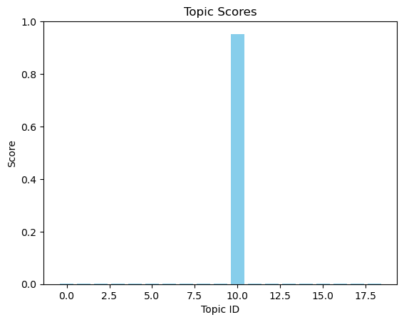
RESULT (2)
Machine learning
analysis
Micro Level
Condition : Within 499 documents and 10 customized topics, how accurate is the interrelatedness of topics and documents?
Document 14 is tested.
Document 14 is shown to belong to topic 10 (Importance of Student Experience )
This topic’s keywords are 'vietnamese', 'student', 'without', 'proficiency', 'chinese', 'put', 'distinct', 'disadvantage', 'affect', 'competitive', 'dynamic', 'within', and 'classroom' which imply the challenges faced by Vietnamese students who lack proficiency in Chinese.
Notes:
The numbers from the table Bags of words (e.g. 0.023 for “work” and 0.022 for “student”) associated with each keyword represent the weight or probability of that word in the given topic = STUDENT supports in meaning for WORK
The keywords for Topic 10 suggest that it revolves around challenges faced by Vietnamese students who lack proficiency in Chinese in a competitive classroom environment.

Slide 18
Discussion
EMI Program
X Challenges
Challenges Faced by Students in Taiwan | Details | Supporting Research
Socio-Cultural Adjustment | Struggles with adapting to Taiwanese culture and social norms | Schweisfurth & Gu, 2009; Ward & Low, 2004
Language Barriers | Significant impact on academic performance and social interactions | Andrade, 2006
Financial Pressures | Difficulty managing living expenses alongside tuition fees, economic impact of studying abroad | Li et al., 2021; Zhang & Goodson, 2011
Health and Well-Being | Less mentioned but remains an important aspect of the study

Slide 19
Extra: Semantic Network Analysis

Slide 20
Discussion
The role of EMI Programs & Higher Education Quality
Role of EMI Programs:
Dual role in international student experiences
Facilitates academic engagement by easing language barriers (Chu et al., 2018)
Quality of EMI programs is crucial
High-quality EMI: Enhances student experience with robust support and inclusive curricula (Ismailov, 2022)
Poor-quality EMI: Exacerbates challenges without adequate support (Merga, 2020)
Mediating Role of Higher Education Quality:
Significant impact on international student challenges
High standards and comprehensive support services improve academic and social outcomes
Aligns with literature on the importance of institutional quality (OECD, 2020; Marambe et al., 2012)
Use of LDA in Study:
Effective in identifying key themes and issues
Highlights the multifaceted nature of challenges and the role of institutional quality

Slide 21
CONCLUSION
The study reveals that socio-cultural and academic challenges are most significant for international students, with financial and health issues less prominent. Language barriers in EMI classrooms, particularly between Chinese and English, impact connections, especially for Vietnamese students. Academic difficulties stem from insufficient English communication standards, while financial struggles are linked to limited job opportunities. Most students are optimistic about their health. The LDA results support these findings, showing socio-cultural and academic challenges as dominant.
Taiwan’s policies, such as the New Southbound Talent Development Program and Bilingual 2030, aim to improve educational quality and international cooperation. To enhance international students' experiences, it is recommended to implement cultural integration programs, improve EMI quality, and provide financial and language support. Universities should offer orientation, language courses, financial counselling, and mental health services. Future research could utilize BERT for deeper insights into students' experiences through advanced NLP techniques.

Slide 22
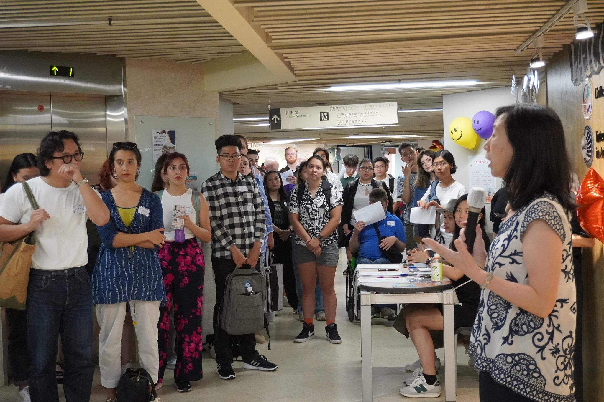
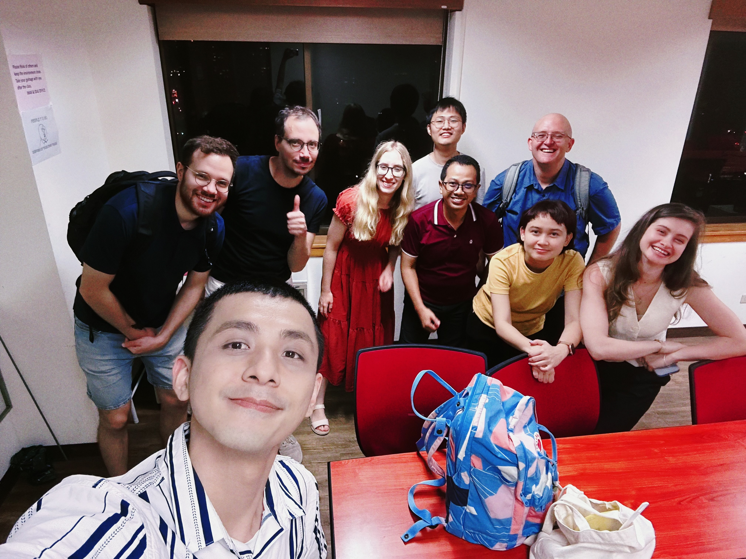
THANK YOU
2024
如果您有任何疑問，請隨時詢問。

